Slide 1
Application Frameworks
Lecturer: Ngo Huy Bien
Software Engineering Department
Faculty of Information Technology
VNUHCM - University of Science
Ho Chi Minh City, Vietnam
nhbien@fit.hcmus.edu.vn

Slide 2

References
Xin Chen. Developing Application Frameworks in .NET. Apress. 2004.
Ralph E. Johnson and Brian Foote. Designing Reuseable Classes. Journal Of Object-Oriented Programming, v.1, n.2. 1988.

Slide 3
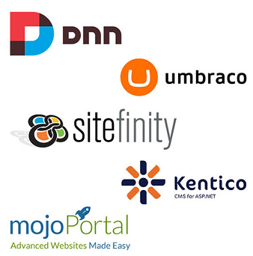
What is an Application Framework? [1]
Framework – a set of reusable designs and code that can assist in the development of software applications.
An application framework provides developers with a structure and template that they can use as a baseline to build their applications.
Such a framework often consists of abstract classes, concrete classes, and predefined interaction among the classes throughout the framework.

Slide 4
Framework [2]
A framework is a set of classes that embodies an abstract design for solutions to a family of related problems, and supports reuses at a larger granularity than classes.
A framework is an abstract design for a particular kind of application, and usually consists of a number of classes. These classes can be taken from a class library, or can be application-specific.
The ability of frameworks to allow the extension of existing library components is one of their principal strengths.
Frameworks can be built on top of other frameworks by sharing abstract classes.

Slide 5
Sample Application Frameworks [1]
Some of the well-known user-interface frameworks are MacApp and MFC, which assist in application development on Macintosh and Windows systems, respectively.
Java and .NET are both frameworks that target all types of applications, and thus such frameworks must not contain any business-domain-related classes and designs.
San Francisco was developed using Java, and it consists of the application frameworks for various business domains, such as order management, warehouse management, and general ledger management.
Unlike general-purpose frameworks such as Java and .NET, the San Francisco framework is designed especially for specific business domains.

Slide 6

Why Application Framework?
Developers can then build the application on top of the framework and reduce the development effort through reuse of code and designs provided in the framework.
Of course, many applications have been developed without using a framework, so you can probably do the job without even knowing the concept of a framework.
In the world of application development, everything can be done, with or without a framework.

Slide 7
Framework Benefits?
Modularity
By dividing the framework into modules, we can maximize productivity by assigning a developer the specific part of the application that would benefit most from that developer's expertise.
Reusability
An application framework provides reusability to the application built on top of it not only by sharing its classes and code, but by sharing its designs as well.
Extensibility
Each business application is unique in its business requirements, architecture, and implementation.
It is impossible for a framework to accommodate such variation by itself, but if a framework is designed in such way that it leaves room for some customization, then different business applications can still use the generic features of the framework, yet at the same time developers will have the freedom to tailor their applications to the unique business requirements by plugging the customized logic into the framework.
Simplicity
Simplicity refers to the way the framework simplifies development by encapsulating much of the control of process flow and hiding it from the developers.
Maintainability
Having a single copy of the framework code base makes the application easy to maintain, because you need to make a change only once when a requirement changes.
The application framework may also contain many layers. When changes do occur, only the components at the layer where the business assumption is broken need to be fixed and tested.

Slide 8
Framework Drawbacks
Additional Development Effort
It is important that those who are developing the framework be competent in both business knowledge and software development.
Without business expertise, you cannot create the business-domain-specific framework layers that developers rely on to offset their lack of knowledge of the business domain.
Without the technical expertise in software development, you cannot transfer the concept of the framework from theory to the concrete framework code that developers can reuse and extend.
Developer Training
Because the users of the framework are the developers who are building the application, user training for the framework means training the developers to use the application framework.
As with any new product and programming model, an application framework contains many APIs, services, and configuration settings that are strange to developers, and it will take some time for developers to work with the framework before they become fluent with it and fully productive in developing applications based on it.

Slide 9
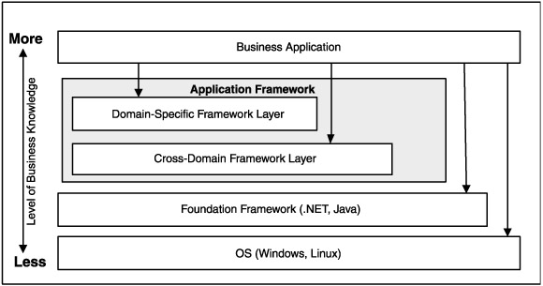
Framework Layers
The Domain-Specific Framework Layer encapsulates and abstracts business-domain knowledge in a form that can be easily adapted by developers in building the actual business application.
The Cross-Domain Framework Layer consists of specialized framework components that target a specific business domain.

Slide 10
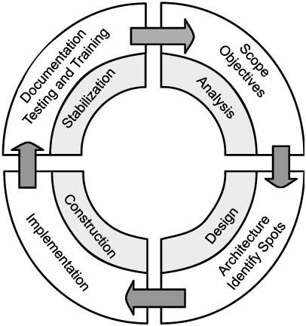
The Framework Development Process
Identify the key features that are to be included in the framework.
What types of business applications will be relying on this framework?
What use cases will the framework support?
How will developers be able to develop their business applications on top of this framework?
Identity the common spots and the hot spots in both the domain-specific layer and the cross-domain framework layer.
Devise an architecture for the framework that will be used as a blueprint during the construction phase.

Slide 11
Framework Documentation
An overview of the framework that explains the purpose of the framework and the major components and services available in the framework.
Some pictures, diagrams, and descriptions of the framework that help developers grasp the framework and its design philosophy.
An API reference for the functionalities inside the framework that enables developers to look up the framework's functionalities during the development process.
A collection of examples that show how the framework is used. Concrete examples of the framework in action best demonstrate the usage scenario of the application framework and help shorten the learning process for developers.

Slide 12
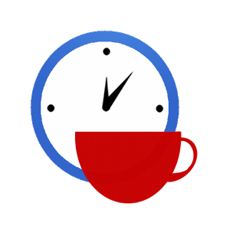

Slide 13
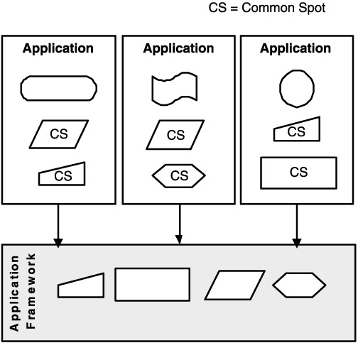
Common Spots
Common spots represent the places in the business application where a common theme is repeated over and over again.
Common spots can exist in both the domain-specific framework layer and the cross-domain framework layer.
By moving such common spots into the framework, you avoid the duplication of such common spots throughout the application, and hence promote code reuse.

Slide 14
Implementation of Common Spots
After identifying a common spot, the framework designer can develop the components that encapsulate the theme and logic in the common spot.
Such components often take the form of concrete classes or executables.
To accommodate the small variations in the component, some configuration data may also accompany the component.
For example, you can allocate certain sections in the configuration file for parameterization of the framework components.
In terms of adapting such framework components, developers need to write little or no code to use the component within the application.

Slide 15
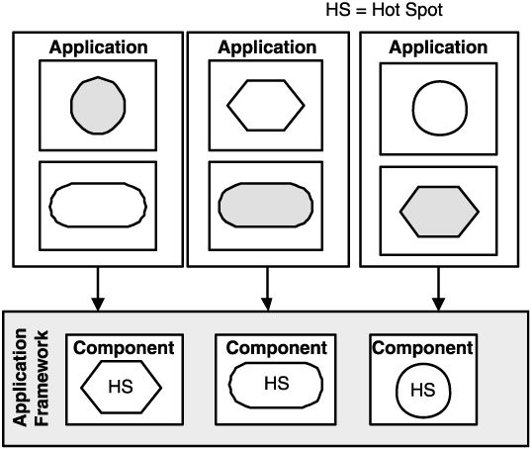
Hot Spots
A hot spot is point of flexibility in the application framework.
It is a placeholder embedded in the framework where application-specific customization occurs.
There is nothing for the framework to implement except to leave an empty placeholder, which is later filled with a custom implementation by the business application built on top of the framework.

Slide 16
Hook Methods
A hook method is a placeholder that will be filled by the application-specific logic.
It is the manifestation of a hot spot concept in an actual class.
A hot spot can be in the form of a class or application, although the method form is the most common manifestation of a hot spot.
It often appears in the form of an abstract method inside an abstract class.
public abstract class BasicBusiness
{
protected float income;
//the template method
public void ReportTax()
{
float sTax = CalculateStateTax();
float fTax = CalculateFedTax();
bool ok = CheckBankBalance(sTax + fTax);
if (!ok)
{
FileBankruptcy();
}
else
{
SendMoneyToGov(sTax + fTax);
}
}
protected abstract float CalculateStateTax();
protected abstract float CalculateFedTax();
}

Slide 17
Filling of the "Hot Spot"
public class NewYorkBusiness : BasicBusiness
{
//implementation of abstract method
protected override float CalculateStateTax()
{
return income * 0.1F;
}
//implementation of abstract method
protected override float CalculateFedTax()
{
return income * 0.2F;
}
}
BasicBusiness nyBusiness = new NewYorkBusiness();
//ReportTax now will use the tax calculation algorithm defined for New York.
nyBusiness.ReportTax();
BasicBusiness caBusiness = new CaliforniaBusiness();
//ReportTax now will use the tax calculation algorithm defined for California.
caBusiness.ReportTax();

Slide 18
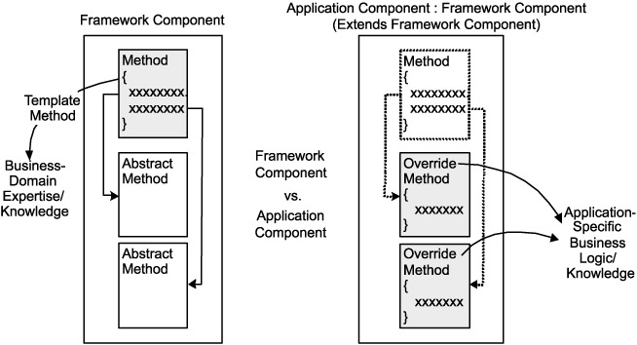
Template Methods vs. Hook Methods

Slide 19
Pluggable Components
To enable hot spots through pluggable components, the application framework must define the interface for the hot spot.
Developers will need to create pluggable application components that have matching interfaces with the hot spot in the framework.
public class NewYorkBusiness : ICalculateTax
{
private float income;
public float Income
{
get { return income; }
set { income = value; }
}
public float CalculateStateTax()
{
return income * 0.1F;
}
public float CalculateFedTax()
{
return income * 0.2F;
}
}
An interface describes a set of methods a class must implement to be considered compatible with the interface.
public interface ICalculateTax
{
float CalculateStateTax();
float CalculateFedTax();
float Income
{
get;set;
}
}

Slide 20
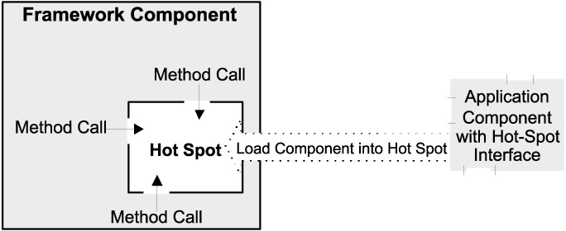
Composition Approach
The developer can then plug the component into the hot spot by binding the application component and the framework component together.

Slide 21
Binding Application Component to Framework Component
// Instead of making an abstract class, we make a concrete class.
public class BasicBusiness
{
public void ReportTax (ICalculateTax calculator)
{
float sTax = calculator.CalculateStateTax();
float fTax = calculator.CalculateFedTax();
bool ok = CheckBankBalance(sTax + fTax);
if (!ok){ FileBankruptcy(); }
else{ SendMoneyToGov(sTax + fTax); }
}
}
ICalculateTax nyBusiness = new NewYorkBusiness();
ICalculateTax caBusiness = new CaliforniaBusiness();
BasicBusiness basic = new BasicBusiness();
basic.ReportTax(nyBusiness);
basic.ReportTax(caBusiness);

Slide 23
Inversion of Control [1]
The methods defined by the user to tailor the framework will often be called from within the framework itself, rather than from the user's application code.
The framework plays the role of the main program in coordinating and sequencing application activity.
This inversion of control gives frameworks the power to serve as extensible skeletons.
Your code calls a library but a framework calls your code.

Slide 24
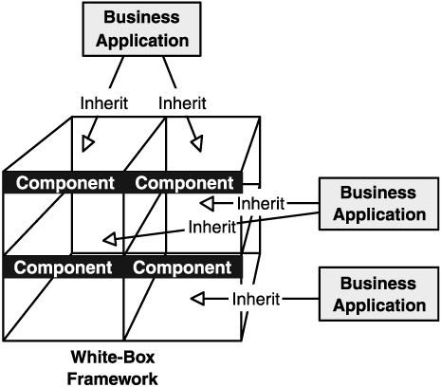
White-box Frameworks [2]
A white-box framework is a framework that consists of abstract classes.
Adapting a white-box framework requires developers to create concrete classes that inherit the abstract classes in the framework.

Slide 25
White-box Frameworks [1]
A framework's application specific behavior is usually defined by adding methods to subclasses of one or more of its classes.
Each method added to a subclass must abide by the internal conventions of its super-classes.
We call these white-box frameworks because their implementation must be understood to use them.
The major problem with such a framework is that every application requires the creation of many new subclasses.
A second problem is that a white-box framework can be difficult to learn to use, since learning to use it is the same as learning how it is constructed.

Slide 26
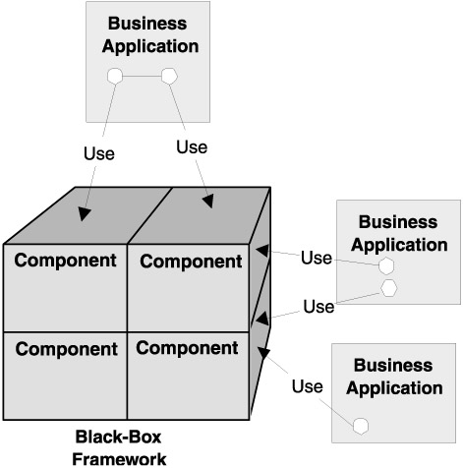
Black-box Frameworks [2]
Black-box frameworks consist of concrete and ready-to-use classes and services.
Although developers can extend the existing framework components to achieve customization in a black-box framework, they more often adapt the framework by combining a number of components to create the desired result.
When using a black-box framework, developers must implement their own process flow and coordination logic needed to link multiple components together.

Slide 27
Black-box Frameworks [1]
Another way to customize a framework is to supply it with a set of components that provide the application specific behavior.
Each of these components will be required to understand a particular protocol.
All or most of the components might be provided by a component library.
The interface between components can be defined by protocol, so the user needs to understand only the external interface of the components.
Thus, this kind of a framework is called a black-box framework.

Slide 28
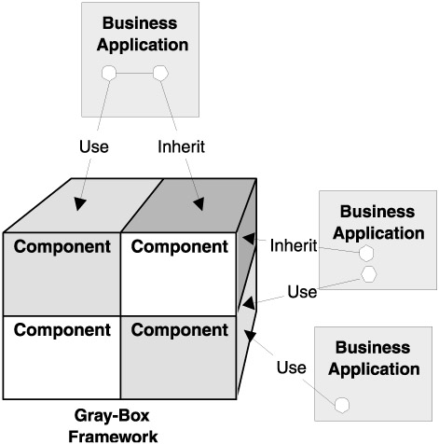
Gray-Box Frameworks
Gray-box frameworks are usually made up with combination of abstract classes and concrete classes.
The approach of enabling its common spots and hot spots is determined on a component-by-component basis.
From the performance point of view, the composition approach tends to be slower than the inheritance approach, primarily because of the extra components it has to load and access at run time to produce the desired results.

Slide 30
Extensibility Requirement
http://msdn.microsoft.com/en-us/library/dd460648%28v=vs.110%29.aspx
Imagine that you are the architect of a large application that must provide support for extensibility.
Your application has to include a potentially large number of smaller components, and is responsible for creating and running them.

Slide 31
Source Code Approach
The simplest approach to the problem is to include the components as source code in your application, and call them directly from your code.
You cannot add new components without modifying the source code.
You may not have access to the source code for the components, because they might be developed by third parties, and for the same reason you cannot allow them to access yours.

Slide 32
Interface Approach
A slightly more sophisticated approach would be to provide an extension point or interface, to permit decoupling between the application and its components.
Under this model, you might provide an interface that a component can implement, and an API to enable it to interact with your application.
This solves the problem of requiring source code access, but it still has its own difficulties.
Registration
Particular Communication

Slide 33
Registration Problem
Because the application lacks any capacity for discovering components on its own, it must still be explicitly told which components are available and should be loaded.
This is typically accomplished by explicitly registering the available components in a configuration file.
This means that assuring that the components are correct becomes a maintenance issue, particularly if it is the end user and not the developer who is expected to do the updating.

Slide 34
Particular Communication
Components are incapable of communicating with one another, except through the rigidly defined channels of the application itself.
If the application architect has not anticipated the need for a particular communication, it is usually impossible.
The component developers must accept a hard dependency on what assembly contains the interface they implement.
This makes it difficult for a component to be used in more than one application, and can also create problems when you create a test framework for components.

Slide 35
CMS Framework
http://www.dnnsoftware.com/ (ASP.NET Web Forms, built-in Active Directory support, very matured solution)
https://umbraco.com/ (ASP.NET MVC, built-in Active Directory support)
http://www.orchardproject.net/ (ASP.NET MVC, no built-in Active Directory support)
http://www.kentico.com/download-demo/free-cms-for-asp-net (built-in Active Directory support, commercial solution)
http://www.sitefinity.com/web-development-platform (built-in Active Directory support, commercial solution)
http://www.yiiframework.com (PHP, Active Directory support via module)
https://www.drupal.org/ (PHP, Active Directory support via module)
https://www.joomla.org/ (PHP, Active Directory support via module)

Slide 37
Middleware
The aim of these middleware platforms is focused on
reducing the application engineering complexity of building multi-tenant software by
shifting this complexity from the application design towards a reusable middleware architecture.

Slide 38
Convention Over Configuration
https://en.wikipedia.org/wiki/Convention_over_configuration
Convention over configuration (also known as coding by convention) is a software design paradigm which seeks to decrease the number of decisions that developers need to make, gaining simplicity, and not necessarily losing flexibility.
The phrase essentially means a developer only needs to specify unconventional aspects of the application.
For example, if there is a class Sale in the model, the corresponding table in the database is called "sales" by default.
It is only if one deviates from this convention, such as calling the table "product sales", that one needs to write code regarding these names.
When the convention implemented by the tool matches the desired behavior, it behaves as expected without having to write configuration files.
Only when the desired behavior deviates from the implemented convention is explicit configuration required.

Slide 39
Why Convention Over Configuration?
Some frameworks need multiple configuration files, each with many settings.
These provide information specific to each project, ranging from URLs to mappings between classes and database tables.
A large number of configuration files with lots of parameters is often difficult to maintain.
For example, early versions of the Java persistence mapper Hibernate mapped entities and their fields to the database by describing these relationships in XML files.
Most of this information could have been revealed by conventionally mapping class names to the identically named database tables and the fields to their columns, respectively.
“Convention over configuration" violates the principle "explicit is better than implicit“.

Slide 40

Thank You for Your Time

